Slide 1
Autonomous Intersection Management
Ahmed Fayed & Alex Winger

Slide 2
Introduction about AIM and Motivation
Idea: Autonomously and efficiently manage/schedule vehicles through an intersection.
Significantly outperform current intersection technology
Minimizes vehicle Delay (better metric than throughput)
“Vehicle collisions at intersections account for anywhere between 25% and 45% of all collisions.” – Kurt Dresnor
Negates the need for expensive infrastructure (i.e. cloverleaf interchanges)
Vastly more adaptable than current systems

Slide 3
Previous Work & Feasibility
Worked on implementing an AIM System for a previous class
“A Multiagent Approach to Autonomous Intersection Management” by Kurt Dresner and Peter Stone
Reservation system using “First Come, First Served” policy
Use of a grid of “reservation” tiles
Dealing with acceleration in the intersection. Consider trajectories where the vehicle accelerates to max velocity, and maintains current velocity
Force a minimum velocity
Ability to change the policy

Slide 4
Project Scope & Implementation
4-way 3-dedicated-lane intersection with a centralized architecture
Keep the number of messages/communication V2V to a minimum, for scalability purposes and respecting each vehicle’s privacy
Assumptions:
Fully autonomous vehicles (Tesla Model S), focusing less on Driver Agents and mostly on the arbiter/Intersection Manager
No communication failure or delay
No execution error
A high resource powerful computer system placed at the intersection powering the Intersection Manager (IM)
To accomplish this we will use ROS, and a visualization software

Slide 5
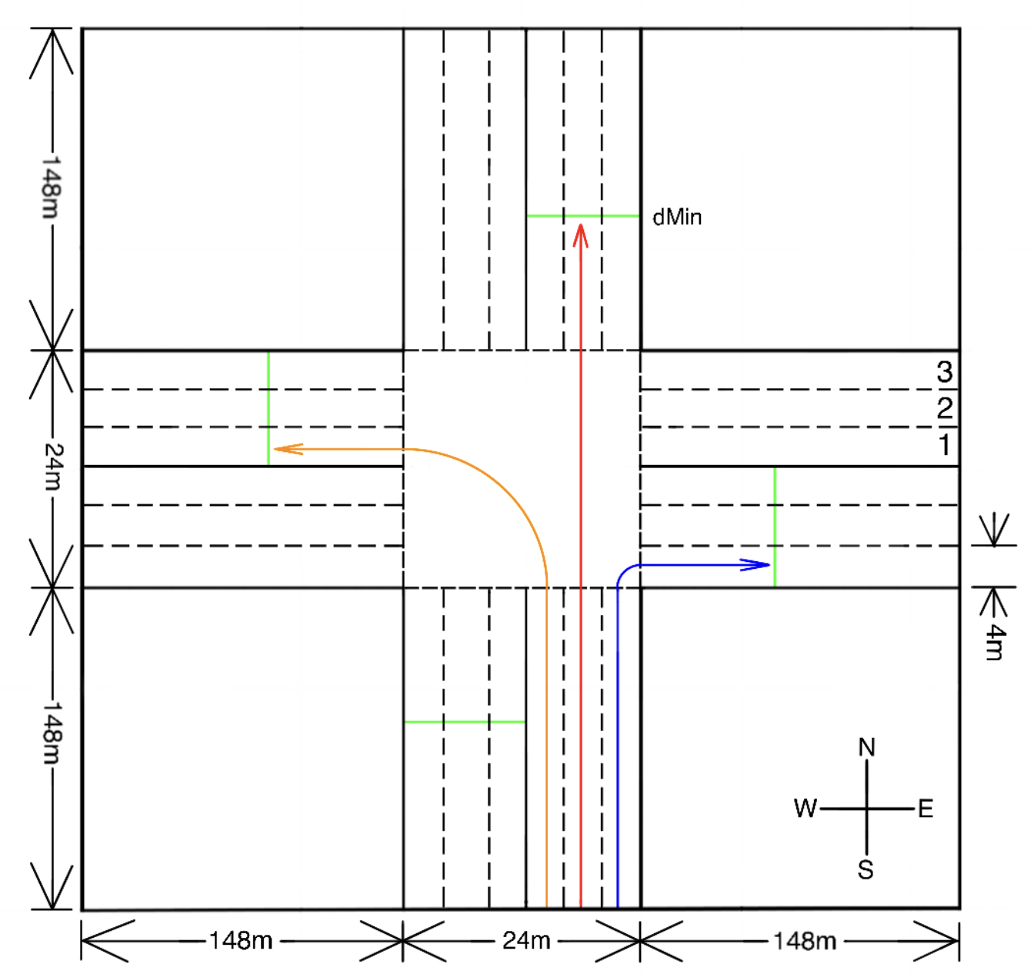
Intersection Layout

Slide 6
Goals & Measures of Success
Our system should:
Have no collisions
Decrease the average delay of vehicles passing through the intersection
Develop a policy for granting reservation requests to vehicles using trajectory planning
Compare our policy with other traffic control policies:
Traditional traffic lights
Stop signs
Dresner and Stone policy
Notes:
Cheaper Intersections???
<number>

